Slide 1


Pylean
By python
Mohammad amin shahidi

Slide 2
What it does? What is done?
Pylean ( python + clean ) is a program which makes you able to check some Clean Code principles in your python code.
Assumed principles may be unique and not necessarily from a particular source.
pylean is python base and uses Nltk library for text processing and Tkinter for GUI development.
Don’t take wrong , it does not check your syntaxes
Did you know that the standard python IDE is made by Tkinter ?

Slide 3
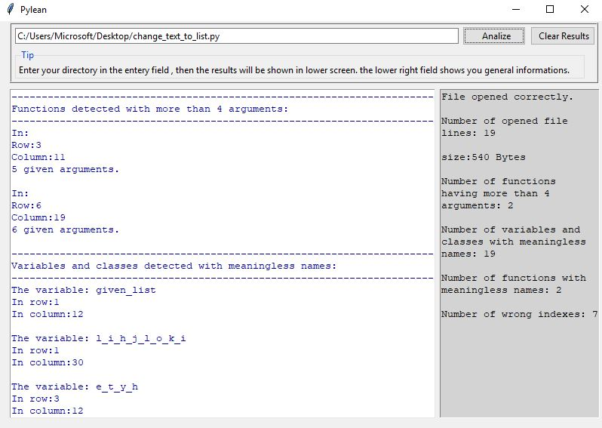
Get started
Generates the results
Clears the pages
Enter your destination
Shows you the results
Shows you some information about opened file

Slide 4
What it shows to user?
Functions with more than 4 arguments.
Variables and classes with meaningless names.
Functions with non-verb names.
Indexes which are characters and does not belong to a specific for block.

Slide 5
How it works?
It’s a function base program.
Each function does a specific thing.
A result can be a combination of several functions return values.
Functions must have a specific design to be used in a Tkinter based program.

Slide 6
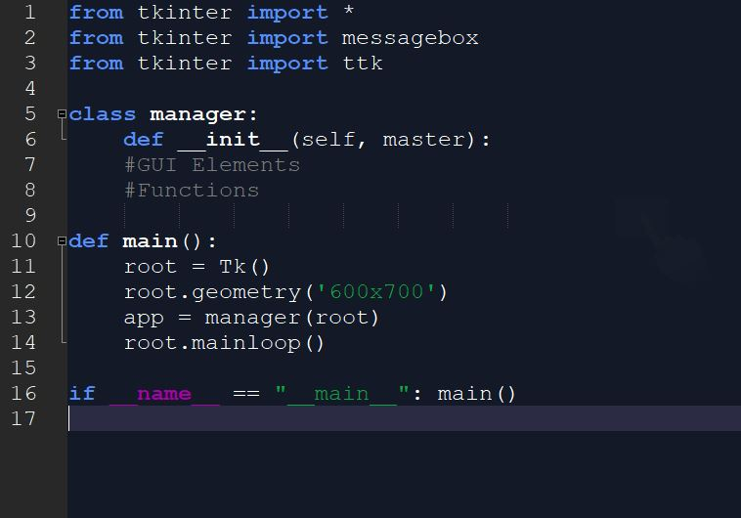
How it works?
Our work zone

Slide 7
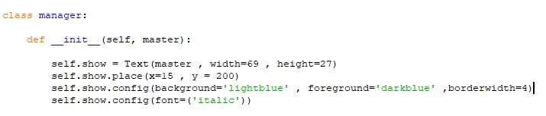
GUI elements

Slide 8
Functions
Why I can’t explain all of them?!
There are 16 different functions that arguments of most of them are return value/s of other one/s.
Some functions are created because of Tkinter platform rules.
So if I decide to explain one function I must explain some others which takes time.
Next , I explain most important ones.

Slide 9
Functions Most important one
The function which recognize words and give us information about them (tokenizer).
Information: Row , Column , Word itself and Type .
Doesn’t result tokens as what we know better “ class instance” .
Puts information in lists (4 ones)

Slide 10
Functions Most important one result
Words
Apple
for
count
C1
…
X
Rows
1
1
2
5
…
Y
Columns
1
25
4
7
…
Z
Types
variable
keyword
function
class
…
W
Token 1
Token
2
Token
3
Token
4
Token n

Slide 11
Functions One that detects for block
To realize if a index belongs to a for block , first , we need to know the position (first row and last row) of are for blocks ( actually we don’t have any blocks in python and it’s better to call it “for zone”).

Slide 12
We detect a for
We detect the index
Check for every line by it’s first word:
Is it placed in a column which makes it belong to the for block?
We detect it’s row and column
Row = 1
Column =1
for i in range ( 0 , 100) :
count = count + I
print ( “THE COUNT : ” + count )
print ( “THE FOR INDEX : ” + i )
def TEST_1 ( VALUE ) :
temp = VALUE * VALUE
return temp
It doesn’t belong to the for block.
So it’s whole line doesn’t
now we know which lines belongs to which for
[ i , 1 , 4] we save this as a “for token”

Slide 13
For indexes
- Now we know which lines every for covers
- We can check for indexes:
“Is the line that index is in it , covered by a for with same index?”
- Yes Ok!
- No Save it as a wrong Index

